Slide 1
Module 1: Agricultural Training Module
Required Content:
Plant biology, lifecycle, and environmental conditions pertinent to growing in the north
Conventional methods of agriculture/farming and their benefits/disadvantages
Different food crops/cultivars locally/globally will also be discussed in their relevance to sustainable northern growing including the agricultural zone map its geographical effect (pending community location)

Slide 2
Organic vs Conventional Farming

Slide 3
Organic vs Conventional Farming Notes (Word Doc)
Organic Farmers
Use _______ approaches
_______ use herbicides and pesticides that are synthetic, or chemical based
Conventional Farmers
Use crop rotations to help crop grow betters
Use _______ pesticides and herbicides to control insects, pests or weeds
Use genetically enhance biotech to ___________to diseases and pests

Slide 4
Organic vs Conventional Farming Key Points
Organic Farmers
Use natural approaches
Do not use herbicides and pesticides that are synthetic, or chemical based
Conventional Farmers
Use crop rotations to help crop grow betters
Use chemical pesticides and herbicides to control insects, pests or weeds
Use genetically enhance biotech to improve resistance to diseases and pests

Slide 5
Organic vs Conventional Farming Quiz
What is the different between Organic Farmer and Conventional Farmer?
What does herbicides and pesticides use for?
Why do conventional farmers use genetically enhance biotech?

Slide 6
What Is A Plant?

Slide 7
What Is A Plant? Key Points
Plants are living organisms
Plants need air, water, nutrients and sunlight to live
Plants is important because they
Form the foundation of the food chain
Produce oxygen for human and animals to breathe
Create important habitats for animals to live

Slide 8
What Is A Plant? Notes (Word Doc)
Plants are ________ _________.
Plants need ________, ________, ________ and ________ to live
Plants is important because they
Form the foundation of the food chain
Produce ________ for human and animals to breathe
Create important habitats for animals to live

Slide 9
Parts Of A Plant

Slide 10
Parts Of A Plant Key Points
Important parts of a plant are leaves, bud, flower, stem, fruit, and roots
The bud protects baby flower or baby leave from harmful elements of nature
Flower is usually colorful and attract insects
Leaf absorbs sunlight and makes food
Fruit is part of the plant that contains excess food and seeds. Not all fruits are sweet and/or edible. Sometimes, it helps the plant in dispersing the seeds
Stem holds the plant upright and carries water, food and nutrients to all part of the plant
The roots absorb water and mineral from the soil. It also acts as an anchor

Slide 11
Parts Of A Plant Notes (Word Doc)
Important parts of a plant are _______, ______, _______, _______, _______, and ________.
The _____ protects baby flower or baby leave from harmful elements of nature.
_______ is usually colorful and attract insects.
_______ absorbs ______ and makes food.
________ is part of the plant that contains excess _____ and ______. Not all fruits are sweet and/or edible. Sometimes, it helps the plant in dispersing the seeds.
________ holds the plant upright and carries water, food and nutrients to all part of the plant.
The _______ absorb water and mineral from the soil. It also acts as an anchor.

Slide 12
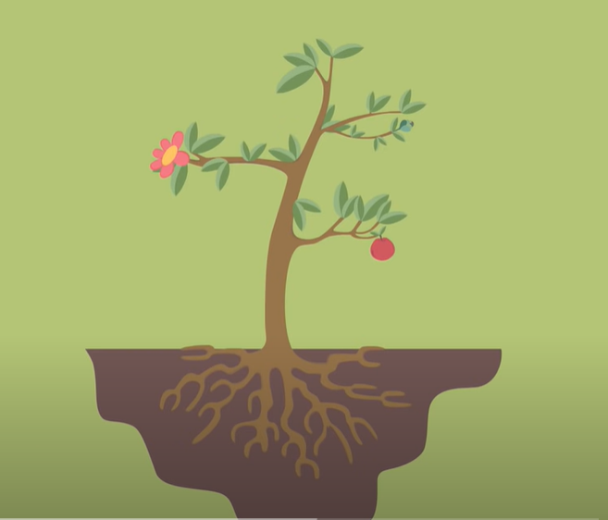
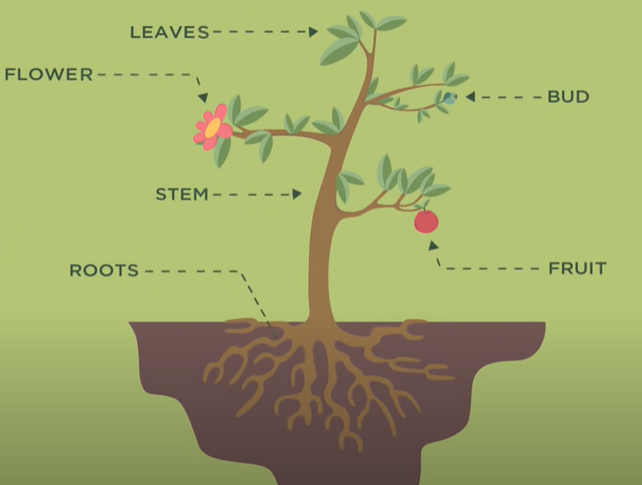
Parts Of A Plant Quiz
What are the important parts of a plant?
What are the roles of each important part? (Matching)
Where does each part located on the plant?

Slide 13
Photosynthesis

Slide 14
Photosynthesis Key Points
Photo means Light
Synthesis means Putting Together
Photosynthesis is using light to put things together
Plants use this process to make their food with the help of sunlight, water and carbon dioxide
Fun Fact: If no sunlight is available, LED growing lights can replace it.

Slide 15
Photosynthesis Notes
Photo means _______
Synthesis means _________
Photosynthesis is using light to put things together
Plants use this process to make their food with the help of _______,___________ and __________
Fun Fact: If no sunlight is available, growing lights can replace it.

Slide 16
Photosynthesis Quiz
What do plants need to make food and how can we give plants access to them?

Slide 17
Plant Nutrition

Slide 18
Plant Nutrition Notes (Word Doc)
Plants get food through _________
Nitrogen is needed to ______________. Without this element, plants will have stunt growth
_____________ is needed to make Chlorophyll which _____________. Without this element, less photosynthesis
Potassium is needed for _______________
Phosphate is needed for ______________
In Hydroponics, plants are grown in ______, not _____ which allows the farmers to have more control over the minerals and conditions that the plants grown in
Artificial Fertilizer are called NPK which stands for __________, __________ and ________ contain in the solution

Slide 19
Plant Nutrition Key Points
Plants get food through Photosynthesis
Nitrogen is needed to make protein. Without this element, plants will have stunt growth
Magnesium is needed to make Chlorophyll which absorb lights. Without this element, less photosynthesis
Potassium is needed for growth and plant immune system
Phosphate is needed for energy transfer
In Hydroponics, plants are grown in water, not soil which allows the farmers to have more control over the minerals and conditions that the plants grown in
Artificial Fertilizer are called NPK which stands for Nitrogen, Phosphorous and Potassium contain in the solution

Slide 20
Plant Nutrition Quiz
What does NPK stands for?
Why is Nitrogen important to plant grow?
Why is Potassium important?
Why is Phosphate important?
What is Hydroponic?

Slide 21
Plant Nutrients

Slide 22
Plant Nutrients Notes (Word Doc)
Macronutrients are ____________, ___________ and ___________ because they are needed by the plants in relatively large amount
Secondary Nutrients are ___________, __________ and _________ because they have important supporting role in plant cellular development
Micronutrients are __________, ___________, ___________, ____________, ____________, ____________, ________ and ___________ because they are needed in small amount. They are just as essential as macronutrients
Non-mineral nutrients are __________, _________ and __________ because they are obtained from the atmosphere and water
____________
Responsible for rapid foliage growth and green color
Easily leaves the soil
Mobile in plant, moving to new growth
_____________
Encourages root formation and growth
Increases quality of seed, fruit, and flower production
Increases disease resistance

Slide 23
Plant Nutrients Notes (Word Doc)
____________
Helps plants overcome drought stress
Improves winter hardiness
Increases diseases resistance
Improves the strength of stems
___________
Is a key part of chlorophyll which helps plants to absorb sunlight during photosynthesis
___________
Helps form chlorophyll
Helps with protein production and making plant oils
Increases crop yields and improves produce quality
____________
Needed in large amounts by all plants for the formation of cell walls and cell membranes
Plays a vital role in soil structure

Slide 24
Plant Nutrients Notes (Word Doc)
___________
Essential for creating new plant cells
Helps with pollination, fruit and seed development
___________
Helps in plant growth and development by regulating the opening and closing of the leaves
___________
Important in plant processes including photosynthesis
Involved in pollen germination, tube growth and root cell elongation
Increases resistance to root pathogens
___________
Plays a critical role in DNA synthesis, respiration and photosynthesis
Essential for maintenance of chloroplast structure and function

Slide 25
Plant Nutrients Notes (Word Doc)
____________
Helps nitrogen change into a form that is usable by the plant
___________
Activate some enzymes in plants
Needed in photosynthesis and respiration
___________
Is an important part of many enzymes and proteins
__________
Is an essential component in enzymes that convert nitrogen into a useable form in the plant

Slide 26
Plant Nutrients Key Points
Macronutrients are Nitrogen, Phosphorus and Potassium because they are needed by the plants in relatively large amount
Secondary Nutrients are Magnesium, Sulfur and Calcium because they have important supporting role in plant cellular development
Micronutrients are Boron, Chlorine, Manganese, Iron, Nickel, Copper, Zinc and Molybdenum because they are needed in small amount. They are just as essential as macronutrients
Non-mineral nutrients are Hydrogen, Carbon and Oxygen because they are obtained from the atmosphere and water
Nitrogen
Responsible for rapid foliage growth and green color
Easily leaves the soil
Mobile in plant, moving to new growth
Phosphorus
Encourages root formation and growth
Increases quality of seed, fruit, and flower production
Increases disease resistance

Slide 27
Plant Nutrients Key Points
Potassium
Helps plants overcome drought stress
Improves winter hardiness
Increases diseases resistance
Improves the strength of stems
Magnesium
Is a key part of chlorophyll which helps plants to absorb sunlight during photosynthesis
Sulfur
Helps form chlorophyll
Helps with protein production and making plant oils
Increases crop yields and improves produce quality
Calcium
Needed in large amounts by all plants for the formation of cell walls and cell membranes
Plays a vital role in soil structure

Slide 28
Plant Nutrients Key Points
Boron
Essential for creating new plant cells
Helps with pollination, fruit and seed development
Chlorine
Helps in plant growth and development by regulating the opening and closing of the leaves
Manganese
Important in plant processes including photosynthesis
Involved in pollen germination, tube growth and root cell elongation
Increases resistance to root pathogens
Iron
Plays a critical role in DNA synthesis, respiration and photosynthesis
Essential for maintenance of chloroplast structure and function

Slide 29
Plant Nutrients Key Points
Nickel
Helps nitrogen change into a form that is usable by the plant
Copper
Activate some enzymes in plants
Needed in photosynthesis and respiration
Zinc
Is an important part of many enzymes and proteins
Molybdenum
Is an essential component in enzymes that convert nitrogen into a useable form in the plant

Slide 30
Plant Nutrients Quiz
What are the Micronutrients?
What are the Macronutrients?
What are the Secondary Nutrients?
What is each element role? Matching

Slide 31
The Amazing Ways Plants Defend Themselves

Slide 32
The Amazing Ways Plants Defend Themselves Key Points
Plants face a number of pests
Lignin is hard to chew (covered in it)
Plants have sharp adaptations to inhibit herbivores
Some plants can even shock people
Plants have immune systems that can deal with specific threats
Some plants can even release scents to be defended by other animals

Slide 33
Plant Adaptations Examples

Slide 34
Plant Adaptations Key Points
Physical and behavioral adaptations take place within plants
Physical adaptations are traits one can see
Cacti have a wide and shallow root system and a thick stem (all for low water content) and are covered in a wax layer to protect water contents
Palm tree leaves have wind and rain pass through them easily
Water lilies are adapted to high water and growing on a bed of water by being large and round, as well as have thorns to fend off animals

Slide 35
Supplementary Videos

Slide 36
Plant Growth Time Lapse
Spinach

Slide 37
Plant Growth Time Lapse
Lettuce in Hydroponics

Slide 38
Plant Growth Time Lapse
Hydroponic Salad

Slide 39
Plant Growth Time Lapse
Hydroponic Basil

Slide 40
Plant Growth Time Lapse
Hydroponic Thyme

Slide 41
Bed Rock Condition

Slide 42
What Do Plants Need to Grow?

Slide 43
Parts Of A Plant

Slide 44
Seeds and the Life Cycle of Plants

Slide 45
Guide Sheets

Slide 46
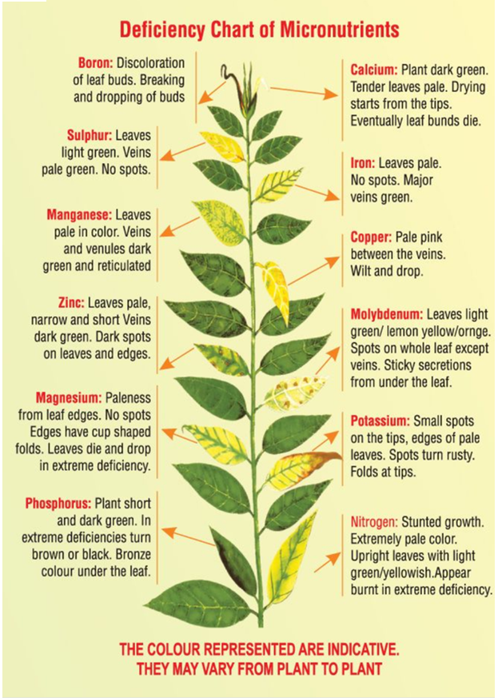

Slide 47
Organic Farming vs. Conventional Farming Guide Sheet
Organic Farming
What is it?
is farming without the use of any synthetic chemicals or industrial fertilizers
relies on natural principles like biodiversity and composting instead to produce healthy, abundant food.
Pros
Environmental sustainability
Lower input costs
Better soil conservation and management
Cons
Diminished productivity in the long-term
Time consuming
Skills required
Organic products are more expensive
Lacks the flexibility of utilizing GMO advantages
Conventional Farming
What is it?
is farming with the use of Genetically Modified Organisms (GMO), chemicals, and fertilizers
Pros
Low Costs, High Gains
Increase of Food Production
Lower Costs of Produce
Cons
Presence of Pesticides
Health and Environmental Hazards due to chemical usage
Disadvantageous to Small Farmers

Slide 48
Tradition and Local Foods Guide Sheet

Slide 49
Background
The foods in this guide are some of the most common and easily identifiable wild foods in Ontario
Within this guide, you may see words in Italics beside the name of the plant, these are the scientific name of the plant.
This guide has been created to help you understand some history and information on foods you may find in the wild, please DO NOT eat something if you are not 100% sure it is edible
For more information on finding foods in nature, please use this guide: https://ontarionature.org/wp-content/uploads/2018/03/Ontario_Nature_Forest_Foraging_Guide_official.pdf
Foods in this guide sheet:
Wild rice
Blueberries
Strawberries
Cedar tea
Three sisters

Slide 50
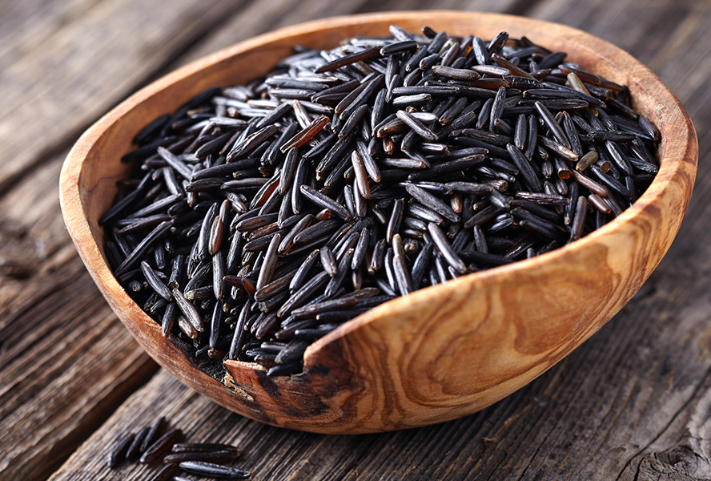
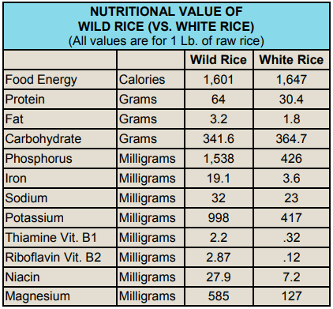
Traditional Food: Wild Rice (Manoomin)
In the Ojibwe language, wild rice (Zizania palustris) is called manoomin, meaning “good berry,” “harvesting berry,” or “wondrous grain.”
Wild Rice is actually not a rice, it is a cereal, which means it is more like wheat than white rice
Wild rice grows all over north America and can be found growing in shallow water in small lakes and in slow-flowing streams and has been traditionally harvested with canoes
The plant usually grows to the surface of the water by mid June and can be harvested in late August
To read more about the history of Wild Rice, visit this webpage: https://www.mnopedia.org/thing/wild-rice-and-Ojibwe
Visit this webpage to see more information on Wild Rice: http://www.omafra.gov.on.ca/CropOp/en/field_grain/spec_grains/wiri.html
Sources: Image - https://www.foodnetwork.ca/shows/great-canadian-cookbook/blog/delicious-ways-to-enjoy-canadian-wild-rice-this-fall/Graph - https://www.nwac.ca/wp-content/uploads/2015/05/2012-Diabetes-Traditional-Foods-and-Recipes.pdf

Slide 51
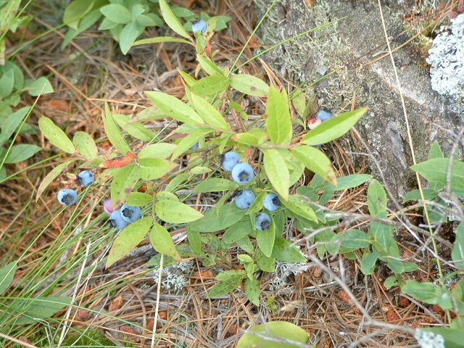
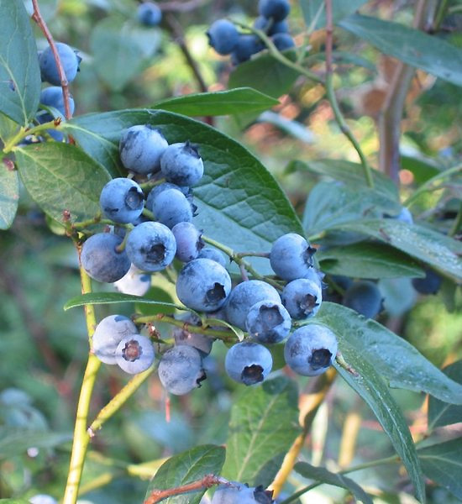
Traditional Food: Blueberries
There are four main types of blueberries: highbush, lowbush, hybrid half-high, and rabbiteye
Wild blueberry bushes are lowbush and only produce fruit every two years
The type of blue berry that you may be used to eating is the highbush variety
Wild blueberries grow throughout Ontario and can be found in high, sunny areas with no trees and slightly acidic soil
Visit this website for more information on blueberries: https://www.almanac.com/plant/blueberries
Above is the lowbush variety (Vaccinium angustifolium) and below is the highbush variety (Vaccinium corymbosum)
Sources: images –
CC BY-SA 3.0, https://commons.wikimedia.org/w/index.php?curid=146498
Public Domain, https://commons.wikimedia.org/w/index.php?curid=1006845

Slide 52
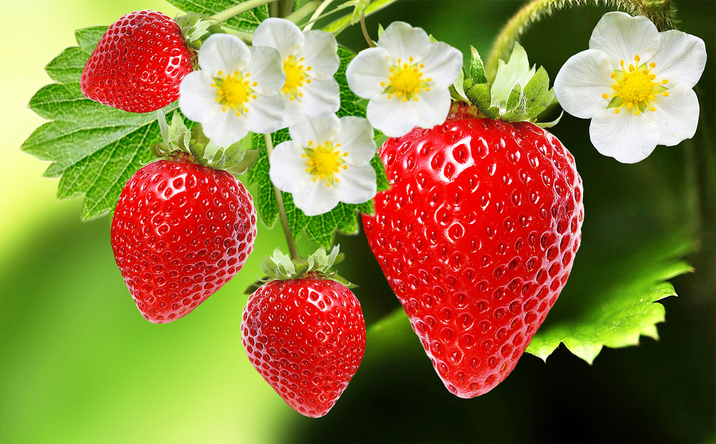
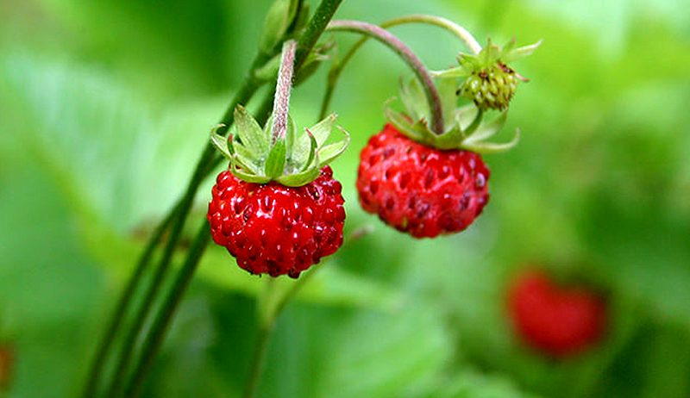
Traditional Food: Strawberries
The strawberry is shaped like a heart and known to some Ojibwe people as the heart berry
Wild strawberries are a common native plant found growing in open fields, woodlands, and undisturbed areas
Wild strawberries are smaller than store bought strawberries, which are a hybrid of the wild strawberry and another variety found in Chile
Please visit this website to read a traditional Ojibwe story about the strawberry: https://glitcsnap.wordpress.com/2014/06/16/the-strawberry-teaching/
Visit this website for more information on strawberries: https://www.almanac.com/plant/strawberries
The image above is a garden strawberry
(Fragaria × ananassa)
The image below is a wild strawberry
(Fragaria virginiana)
Sources: image - https://www.britannica.com/plant/strawberry
https://www.hobbyfarms.com/wild-vs-garden-strawberries-which-one-should-i-grow/
Story - https://glitcsnap.wordpress.com/2014/06/16/the-strawberry-teaching/

Slide 53
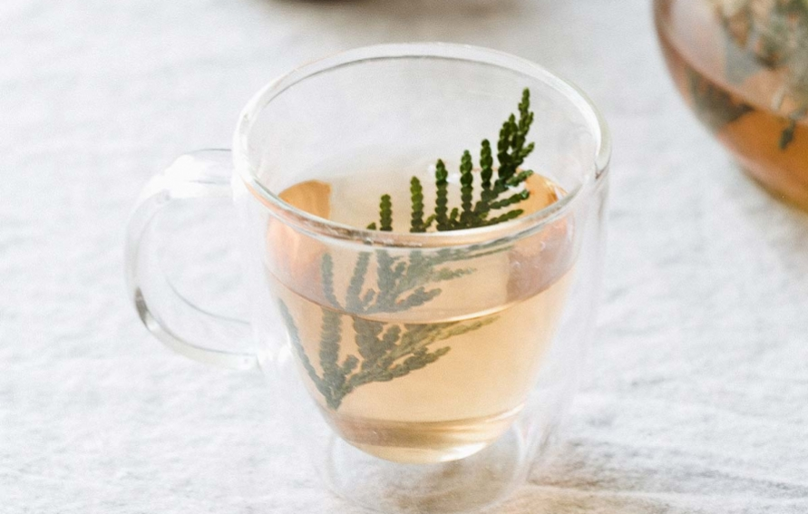
Traditional Food: Cedar Tea
Cedar (Thuja occidentalis) is a traditional medicine of native people all around North America
Cedar tea is said to have many medicinal benefits. It can reduce fevers and relieve symptoms of colds and the flu.
Cedar tea has lots of vitamin C and can help cure scurvy, but it is not recommended that you drink more than 3 cups per week
On one of Jacques Cartier’s voyages to Canada around the year 1535, his crew fell ill to scurvy and were saved by the Iroquoian people and their knowledge of how to use the land.
Each community has different traditions and may have a different way to collect cedar and prepare the tea. If there is not an elder in your community that can teach you how to make this, we have prepared a website: http://www.7generations.org/making-cedar-tea/
For more history on scurvy, visit this website: https://www.thecanadianencyclopedia.ca/en/article/scurvy
Sources: image - https://ediblemichiana.ediblecommunities.com/recipes/cedar-tea

Slide 54
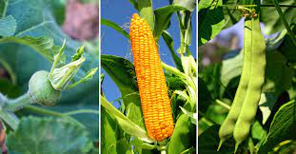
Traditional Food: Three Sisters
Please visit this website to read 3 legends about the three sisters: https://www.nsuok.edu/heritage/three-sisters-legend.aspx
“Corn provides tall stalks for the beans to climb so that they are not out-competed by sprawling squash vines. Beans provide nitrogen to fertilize the soil while also stabilizing the tall corn during heavy winds. Beans are nitrogen-fixers meaning they host rhizobia on their roots that can take nitrogen, a much needed plant nutrient, from the air and convert it into forms that can be absorbed by plant roots. The large leaves of squash plants shade the ground which helps retain soil moisture and prevent weeds.”
“A diet of corn, beans, and squash is complete and balanced. Corn provides carbohydrates and the dried beans are rich in protein and have amino acids absent from corn. Squash provides different vitamins and minerals than corn and beans. These three crops are also important because they can all be dried and used for food year round.” - https://www.nativeseeds.org/blogs/blog-news/how-to-grow-a-three-sisters-garden
Sources: image - https://modernfarmer.com/2018/06/three-sisters-garden-planting-corn-beans-squash-together/

Slide 55
Supplementary Material
Traditional Foods & Recipes on the Wild Side - https://www.nwac.ca/wp-content/uploads/2015/05/2012-Diabetes-Traditional-Foods-and-Recipes.pdf
For Thunder Bay: https://www.almanac.com/gardening/planting-calendar/on/Thunder%20Bay
For Other Regions In Ontario: https://www.almanac.com/gardening/planting-calendar/on

